Slide 1
INTERNATIONAL SERVICE
New Scholarship/Exchange Opportunities
Wooj Byun

Slide 2


Slide 3
NEW GENERATION SERVICE EXCHANGE
Short term exchange from 1 to 6 months
Can be for an individual or a group
Available for university students and professionals up to age 30
Host Club pays nothing
Please encourage young folks to apply!

Slide 4
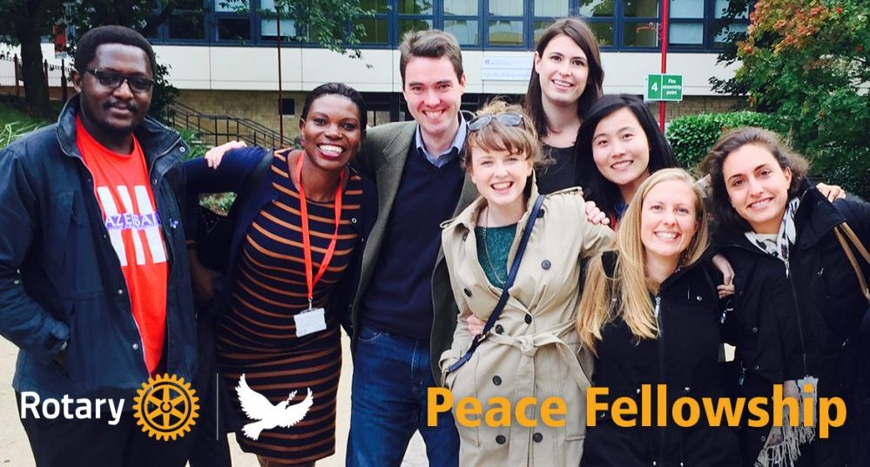

Slide 5
PEACE FELLOWSHIP
Program lasts from 3 months to 24 months
Program participants attend one of our seven (soon to be eight) Rotary Peace Centers:
  Thailand, Japan, England, USA, Sweden
May 31 District Deadline, July 1st Interview Deadline
Funded by Rotary International

Slide 6
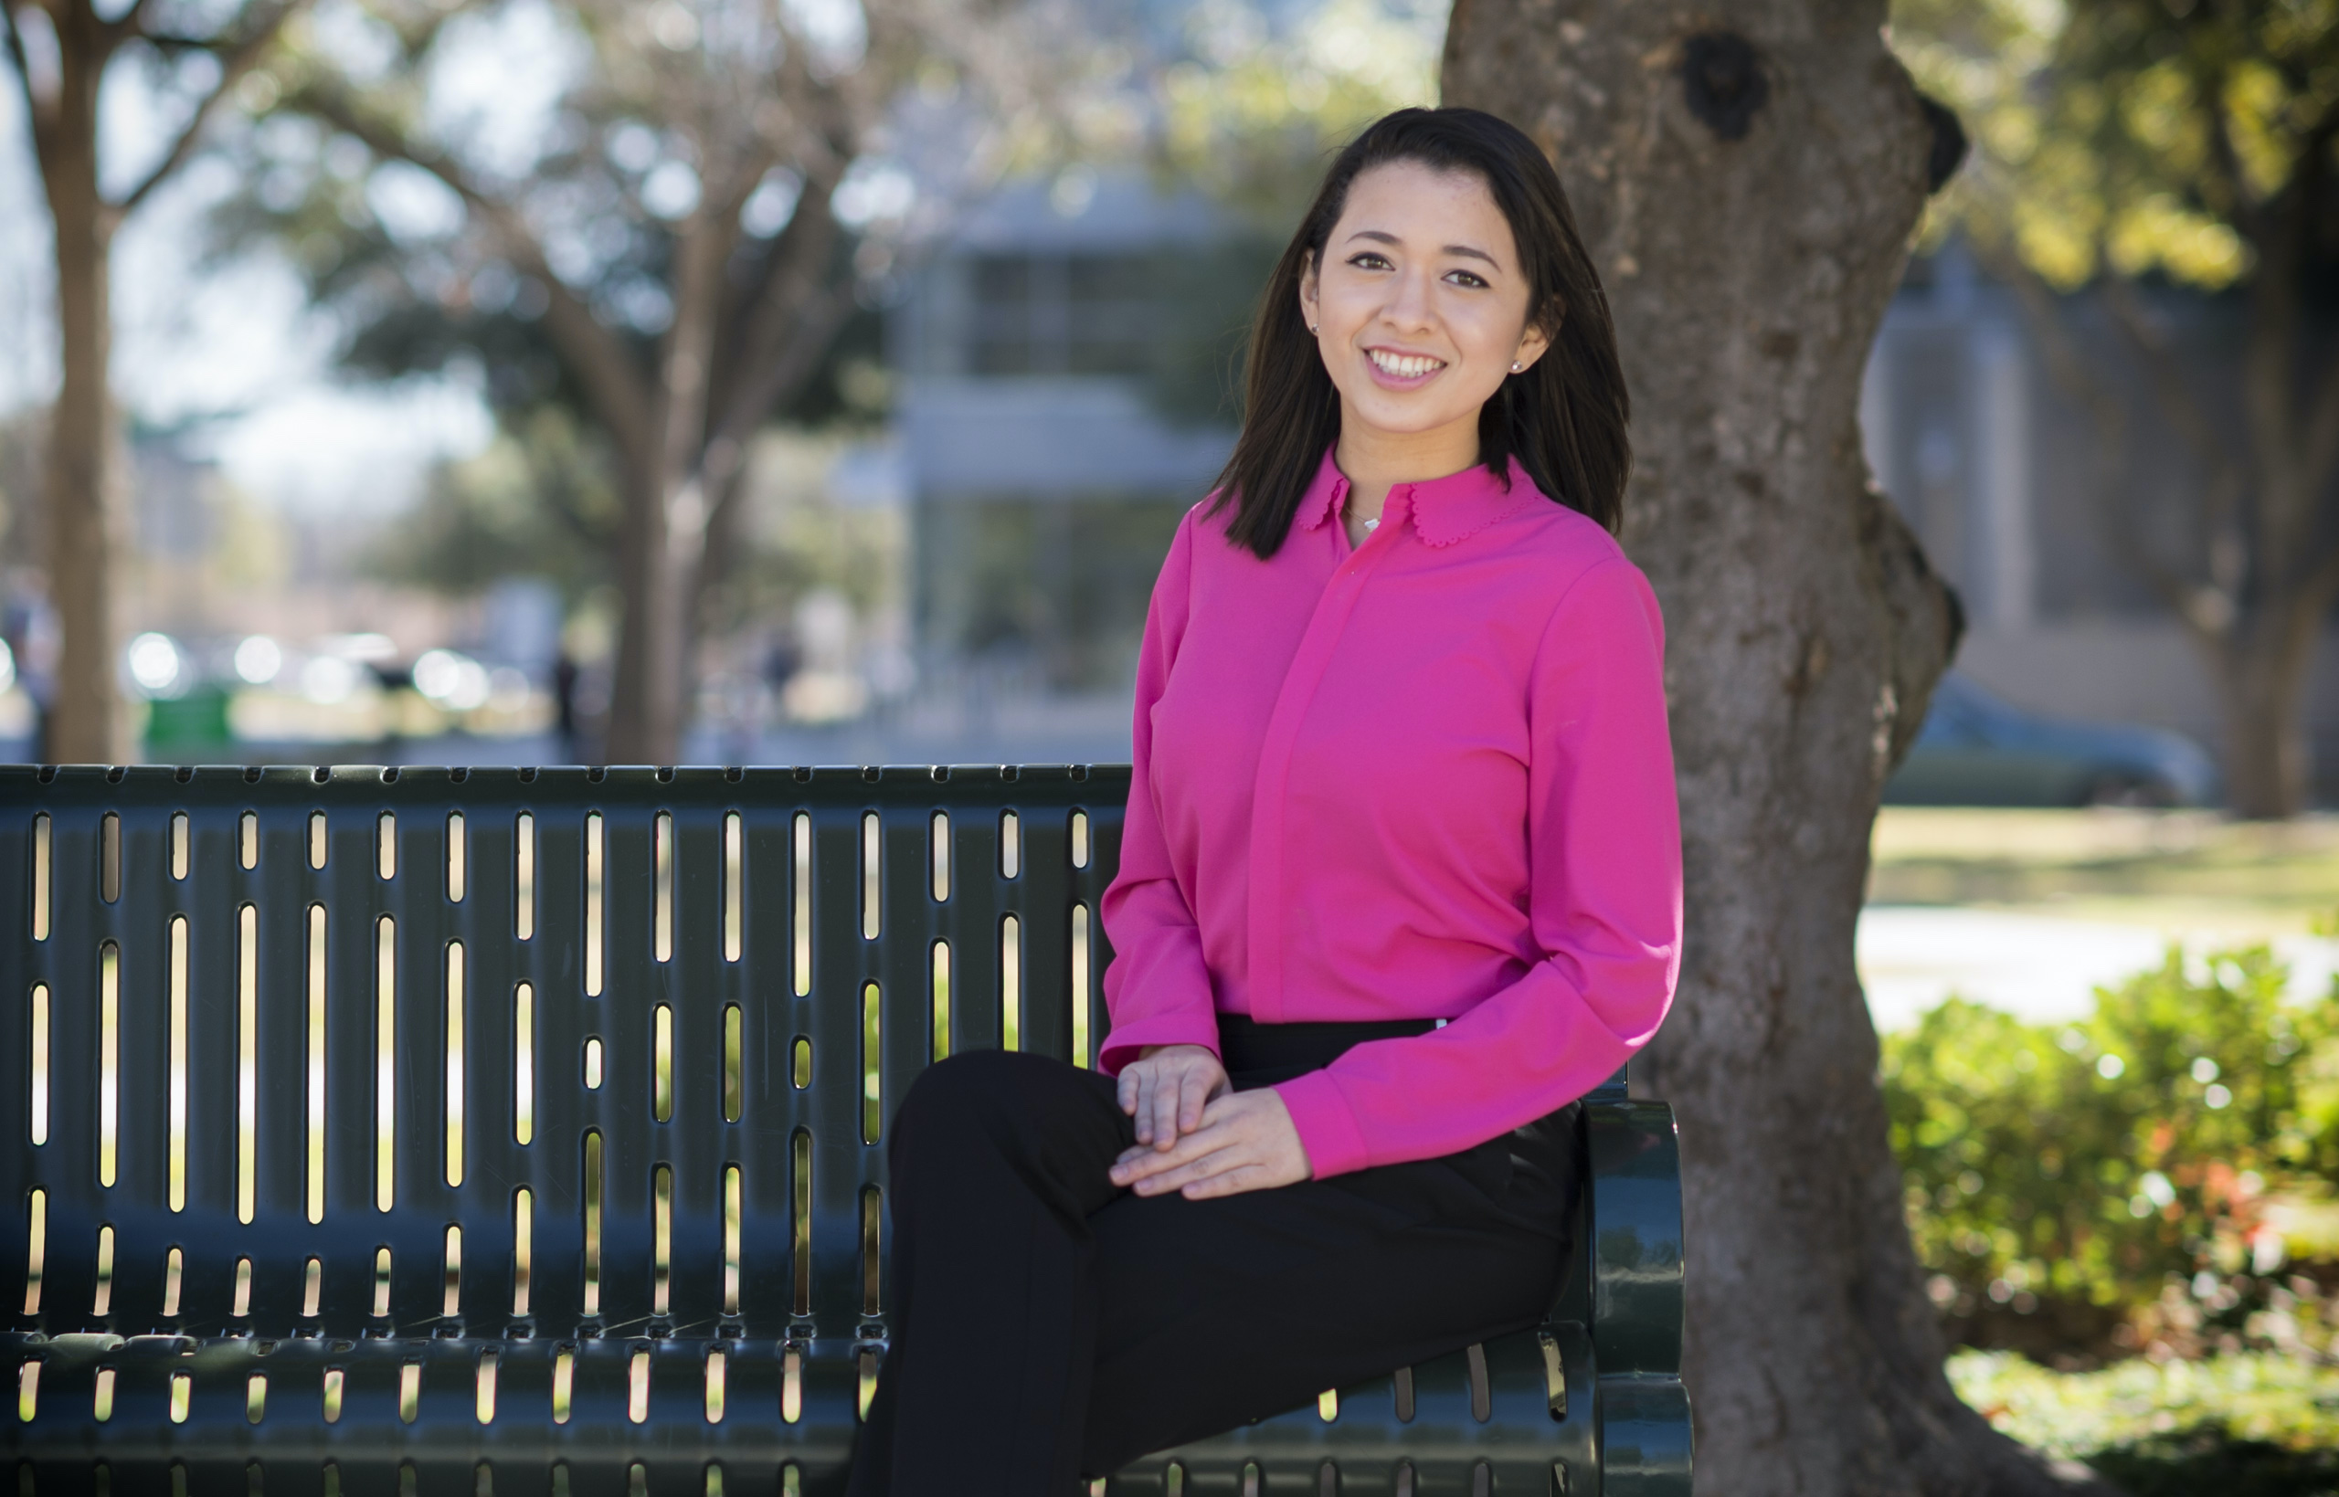


Slide 7
GLOBAL GRANT SCHOLARSHIP
Scholarships for graduate students studying abroad in one of Rotary’s six areas of focus:
Promoting peace, fighting disease, providing clean water and sanitation, saving mothers and children, supporting education, and growing local economies
Scholarships last one to four years
Deadline is June 30
Funded by the District

